Slide 1


Green Pace
Security Policy Presentation
Developer: Zancran Togbe

Slide 2

OVERVIEW: DEFENSE IN DEPTH
Green Pace builds and monitors robust applications with multi-layer security against attacks to ensure business and customer satisfaction. Software development at Green Pace requires consistent implementation of secure principles to all developed applications

Slide 3
THREATS MATRIX
Unlikely 6-Incorporate diagnostic tests using assertions 7-Handle all exceptions | Probable 1-Ensure that integer conversions do not result in lost or misinterpreted data 2-Ensure that operations on signed integer do not result in overflow 9-Ensure that unsigned integer operations do not wrap | Likely 3-Guarantee that storage for strings has sufficient space for character data and the null terminator 4-Sanitize data passed to complex subsystems 5-Do not access freed memory 8-Exclude user input from format strings 10-Only free memory allocated dynamically
Low priority P1 P4 | Medium Priority P6 P9 | High priority P18

Slide 4
10 PRINCIPLES
PRINCIPLES | CODING STANDARDS
Validate input data | SQL Injection, string correctness, data type, authentication
Heed Compiler warnings | Data type, string correctness, memory protection
Architect and design for security policy | Match all 10 coding standards and triple A
Keep it simple | Memory protection : Do not access freed memory
Default Deny | Triple A
Adhere to the principle of least privilege | Data value string injection: Exclude user from input format strings
Sanitize data sent to other Systems | SQL Injection : Sanitize data passed to complex subsystems
Practice defense in depth | Exceptions : Handle all exceptions , Accounting
Use effective quality assurance techniques | Assertions: Incorporate diagnostic tests using assertions
Adopt a secure coding standards | Match all 10 coding standards and triple A

Slide 5
CODING STANDARDS
Coding Standards | Ranks | Explanations
Ensure that integer conversions do not result in lost or misinterpreted data | 2 | Has less chance to occur and can result in the execution of arbitrary code, buffer overflow
Ensure that operations on signed integer do not result in overflow | 2 | Has less chance to occur and can result in the execution of arbitrary code, buffer overflow
Guarantee that storage for strings has sufficient space for character data, and the null terminator | 1 | Has great chance to occur and can result in the execution of arbitrary code, buffer overflow
Sanitize data passed to complex subsystems | 1 | Has great chance to occur and can result in the execution of arbitrary code, triggers commands or actions
Do not access freed memory | 1 | Has great chance to occur and can result in the execution of arbitrary code, accessing dangling pointers
Incorporate diagnostic tests using assertions maps with the three principles | 3 | Has very less chance to occur and can result in the execution of arbitrary code or DOS
Handle all exceptions | 3 | Has very less chance to occur and can result in the execution of arbitrary code or DOS
Exclude user from input format strings | 1 | Has great chance to occur and can result in the execution of arbitrary code, view stack and memory content
Ensure that unsigned integer operations do not wrap | 2 | Has less chance to occur and can result in the execution of arbitrary code, buffer overflow
Only free memory allocated dynamically | 1 | Has great chance to occur and can result in the execution of arbitrary code, heap corruption

Slide 6
ENCRYPTION POLICIES
Encryption | Explain what it is and how and why the policy applies.
Encryption in rest | It is the process of translating archived data or data stored in a database into another form of data that unauthorized users can not decrypt. Green Pace encrypts all customer data stored at rest (Full disk, files, tokens, credentials, and folder )without any action required from the customer with one or more encryption mechanisms. The company uses several layers of encryption to protect data integrity and confidentiality using public encryption algorithms such as AES 256 OR AES128.
Encryption at flight | It is the process of translating data in transit into another form of data that unauthorized users can not intercept and decrypt. Green Pace encrypts all customer data in flight (Full disk, files, and folder ) to ensure delivery without eavesdropping, interception, and forgery. The company uses an appropriate configuration of servers to allow clients to connect securely. For example, Green pace uses transport layer security(TLS) for HTTPS and avoid self-signed certificate.
Encryption in use | It translates data into another form of data while using this data, protecting data integrity and confidentiality. Green Pace is compliant and encrypts all customer-sensitive data in use, such as passwords, credit cards number, and social security. The company use public encryption algorithms such as AES 256 OR AES128

Slide 7
TRIPLE-A POLICIES
Triple-A Framework | Explain what it is and how and why the policy applies.
Authentication | It allows identifying who is requesting a connexion to the application to prevent the various attacks (data breach, phishing, injection, ..etc.). Green Pace application provides a multi-layer of authentication based on user success or failure and level of access. The basic authentication mechanisms require user logins. Other types of authentication, such as multi-factor, certificate-based, token-based, and biometric, are used based on the risk assessment. Passwords are encrypted during storage and transmission and constructed to resist attack
Authorization | It allows users to access certain functionalities based on their privileges. Green Pace enforces the least privileges principle to avoid broken access control, ranked as the fifth most concerning web security vulnerability in OWASP 2017 TOP 10. The company adopts deny by default and uses both role-based access control and attribute-based access control. For example, changes to the database, addition of news users, files access, and user level of access are controlled by administrators with different privileges. Every request must be validated and exit safely when authorization checks fail.
Accounting | It tracks what happens after authentication and authorization, what resources have been used by who, and when. Green Pace applications store accounting records on a dedicated server to allow rapid response in an attack.

Slide 8
Unit Testing
Buffer overflow/ arbitrary code execution
// Create a test to verify adding five values to collection
TEST_F((CollectionTest, CanAddFiveValuesToVector)
{
add_entries(5);
// is the collection still empty?
ASSERT_FALSE(collection->empty());
// if not empty, what must the size be?
ASSERT_EQ(collection->size(), 5);
}

Slide 9
Unit Testing
Denial of service
Create a test to verify the std::out_of_range exception is thrown when calling at() with an index out of bounds
// NOTE: This is a negative test
TEST_F(CollectionTest, EnsureOutOfRangeExceptionWhenCallingIndexOutOfBounds)
{
// set up collection to 5 integers
add_entries(5);
// verify out of range exception is thrown
EXPECT_THROW(collection->at(5), std::out_of_range);
}

Slide 10
Unit Testing
Data breach / data lost
//Positive test
// create a test to verify that the collection last element value is returned
TEST_F(CollectionTest, EnsureBackReturnCollestionLastElementValue)
{
// set up collection to 5 integers
add_entries(5);
// add value 6 at the index 5
collection->push_back(6);
// verify if collection back return 6
EXPECT_EQ(collection->back(), 6);}
}

Slide 11
Unit Testing
Buffer overflow/ arbitrary code execution
// Create a test to verify reserve increases the capacity but not the size of the collection
// positive test
TEST_F(CollectionTest, EnsureReserveIncreaseCapacityButNotCollectionSize)
{
// set up collection to 5 integers
add_entries(5);
// verify collection size equal 5
EXPECT_EQ(collection->size(), 5);
// verify collection capacity greater or equal to 5
EXPECT_GE(collection->capacity(), 5);
// use reserve to increase collection capacity
collection->reserve(10);
// verify new collection capacity
EXPECT_FALSE(collection->capacity()< 10);
EXPECT_GE(collection->capacity(), 10);
// verify if collection size remains the same
ASSERT_EQ(collection->size(), 5);
}

Slide 12
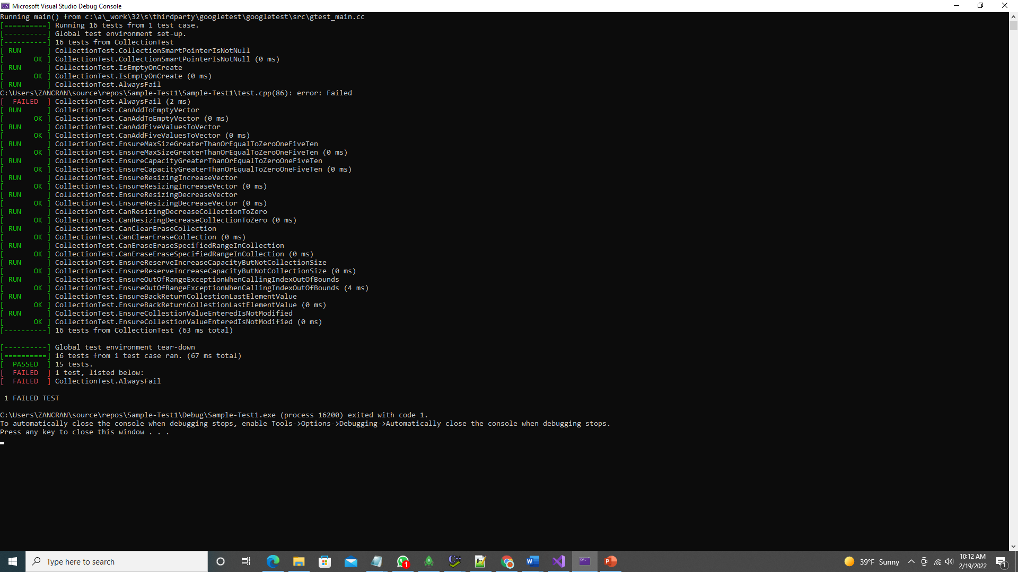
Unit Testing
Test results

Slide 13

AUTOMATION SUMMARY

Slide 14
TOOLS
The existing devops process put security at the end, but the devSecOps integrate security at the left.
In the pre-production phase, specifically after the design step, as soon as the developer commits into the folder or during the pre-build, IDE plugins and SCA/SAST tools are used to run static analysis tools, detect and fix vulnerabilities found early in development based on the standards in this policy. The code continues to be scanned during the post-build steps, including the production phase with dynamic analysis tools (DAST) for penetration test, intrusion detection, …etc. The process follows continuous integration and a continuous deployment pipeline.

Slide 15
RISKS AND BENEFITS
Benefits if you act now (devSecops):
1-Detect bugs and vulnerabilities early
2-Eliminate repair cost
3-Increase productivity
4-Favor the use of defense in depth strategies
5-Apply secure coding best practices
6-Plan threat security debt and model threat
7-Ability to respond to threats

Slide 16
RISKS AND BENEFITS
Risks if you act now (devops):
1-Software released with bad quality
2-Huge repair cost
3-Delay in releasing the software
4-Increase software vulnerability
5-Lack of defense in depth strategies

Slide 17
RECOMMENDATIONS
The security policy must be updated periodically to integrate best practice against new vulnerabilities
The security policy must consider different languages
The security policy must also update the security tools.
The security policy must compliant
The security policy must include ethical recommendations

Slide 18
CONCLUSIONS
Green Pace might adopt other coding standards related to
input output, containers, object oriented, API, declarations and initialization to prevent future attacks.

Slide 19
REFERENCES
Special publication 800-12: An introduction to computer security: The NIST Handbook. NIST SP 800-12: Chapter 5 - Computer Security Policy. (n.d.). Retrieved February 19, 2022, from https://csrc.nist.rip/publications/nistpubs/800-12/800-12-html/chapter5.html
Confluence. How this Coding Standard Is Organized - SEI CERT C++ Coding Standard - Confluence. (n.d.). Retrieved February 19, 2022, from https://wiki.sei.cmu.edu/confluence/display/cplusplus/How+this+Coding+Standard+Is+Organized#HowthisCodingStandardIsOrganized-RiskAssessment
SQL Injection. SQL Injection | OWASP Foundation. (n.d.). Retrieved February 19, 2022, from https://owasp.org/www-community/attacks/SQL_Injection
Seacord, R. C., & Pethia, R. D. (2015). Secure coding in C and C++. Addison-Wesley.

